Slide 1
Retail Electricity Rate Design and the Clean Energy Transition
7th Annual Workshop on the Economics of Electricity Policy and Markets
Ivey Policy and Management Center
October 16, 2023
Meredith Fowlie
UC Berkeley

Slide 2

Electricity markets and the clean energy transition
Two-step plan for deep decarbonization:
  Generate clean electricity
  Electrify everything
This will require big investments in a cleaner, larger, more resilient power system.

Slide 3
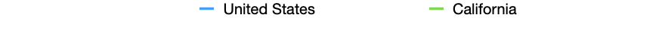
As power sector costs rise, so do retail prices
Average Residential Electricity Prices
High volumetric rates disproportionately impact disadvantaged households.
Affordability concerns loom large in areas with high prices.
California could foreshadow trends in other jurisdictions with rising fixed electricity costs and increasing climate ambition.
Source: US Energy Information Administration

Slide 4
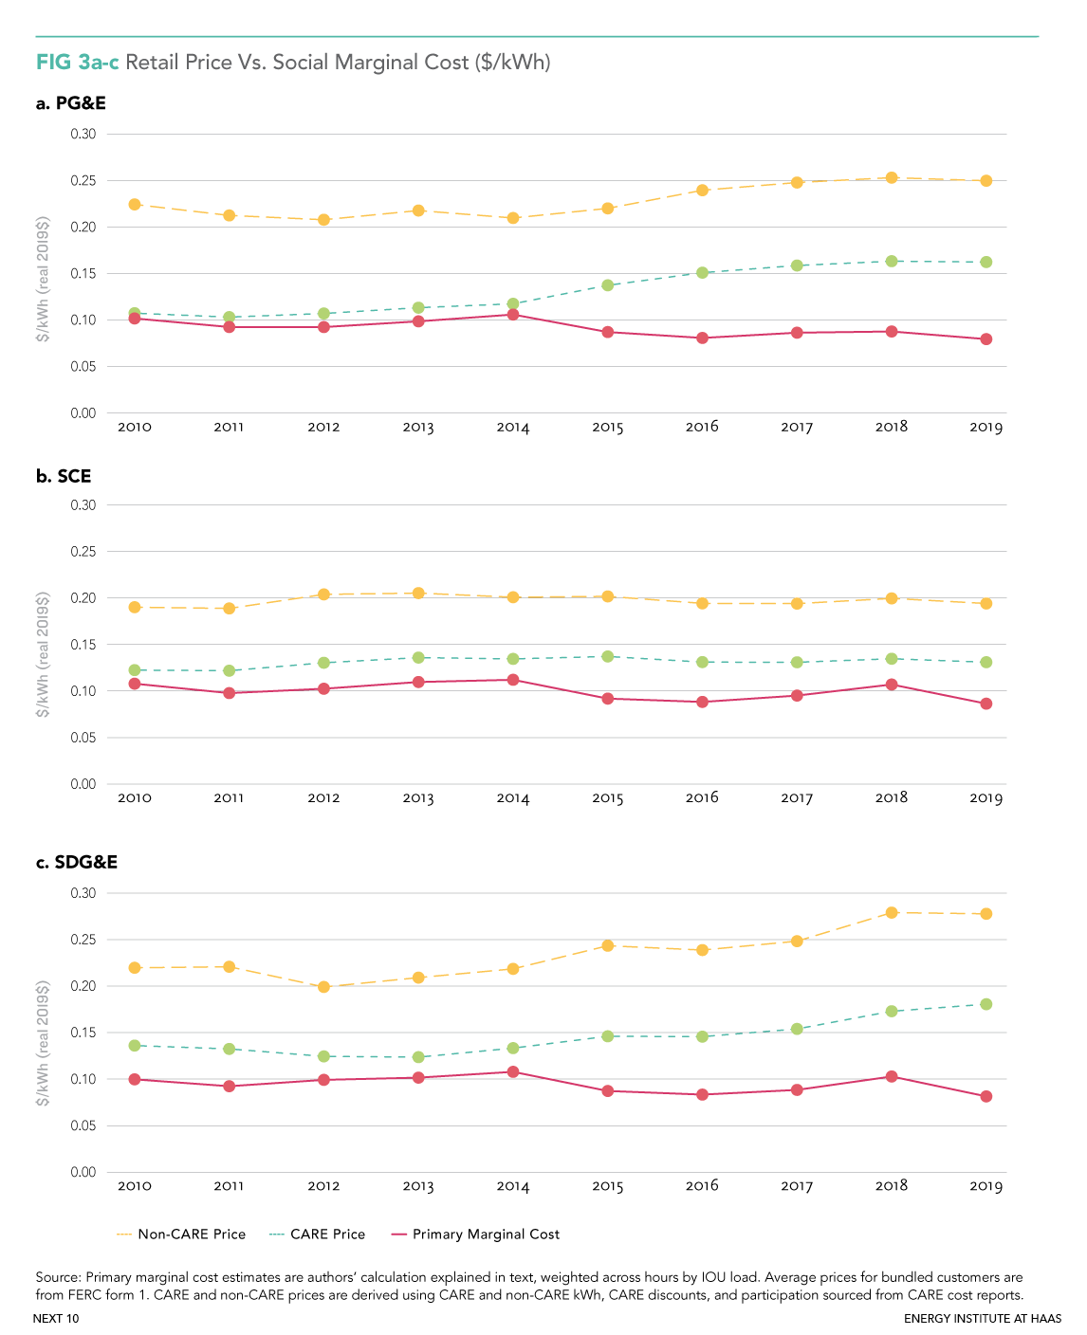
Residential prices versus social marginal cost ($/kWh)

Slide 5

What is driving the gap between price and SMC?
Legacy infrastructure costs
Legacy energy contracts that are now above market
Vegetation management
Distribution system maintenance and upgrades
Grid hardening/wildfire risk mitigation
Wildfire victim compensation (due to “inverse condemnation”)
Subsidies for new technology R&D
Energy efficiency programs, EV charging stations
Subsidies for low-income customers
Net energy metering for rooftop solar (due to P>>SMC)
…and prices are set to rise further relative to SMC

Slide 6
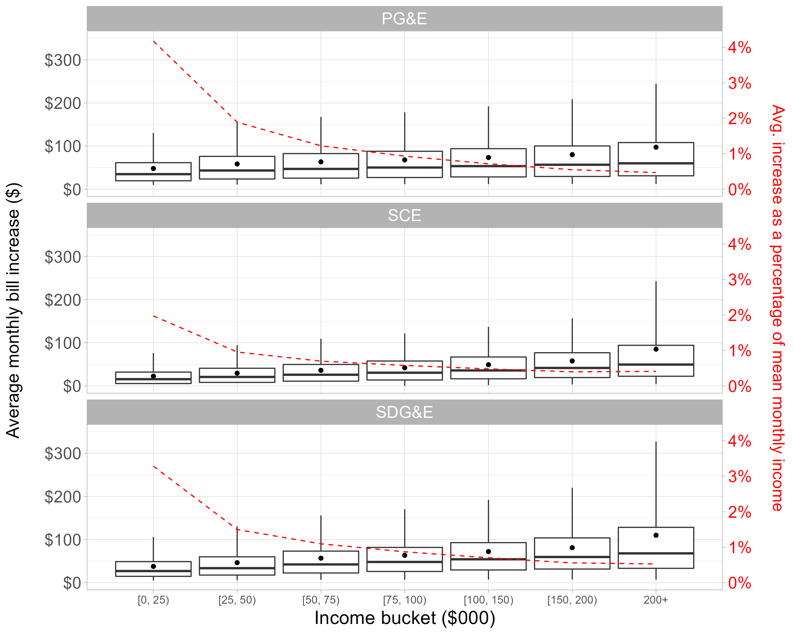
Monthly Residual Cost Burden by Income Category (2019)
Richer households pay more per year towards residual cost recovery.
But lower income households pay a much higher share of income.
This “electricity tax” is quite regressive.

Slide 7
Solutions?
The current rate structure (high volumetric prices above SMC to recover non-incremental costs) is slowing progress on electrification and amounts to a relatively regressive tax.
There are feasible rate reforms that are both good for the climate and good for affordability/equity.
We consider how an alternative rate shifts the burden of fixed cost recovery in the power sector.

Slide 8
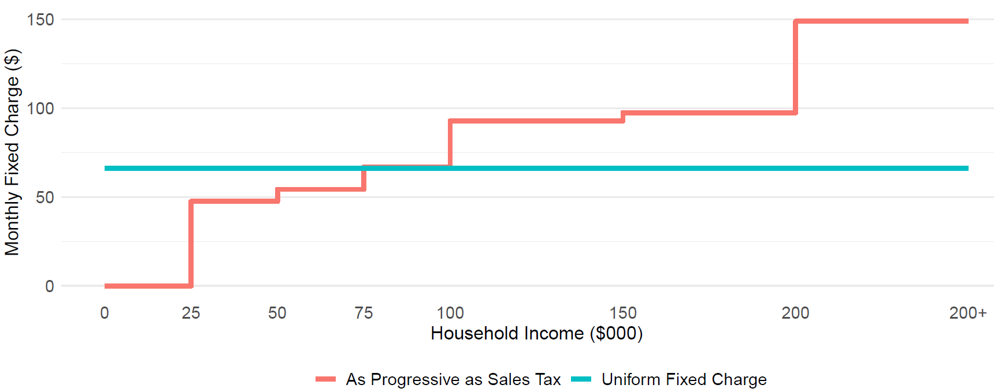
Example of Income-graduated Fixed Charge (PG&E)
In PG&E, a uniform monthly fixed charge would be $67 in 2019 to recover same revenue with P=SMC (green line).
Red line shows an income-graduated fixed charge (IGFC) that matches progressivity of sales tax.
Example of Income-Based Fixed Charge

Slide 9
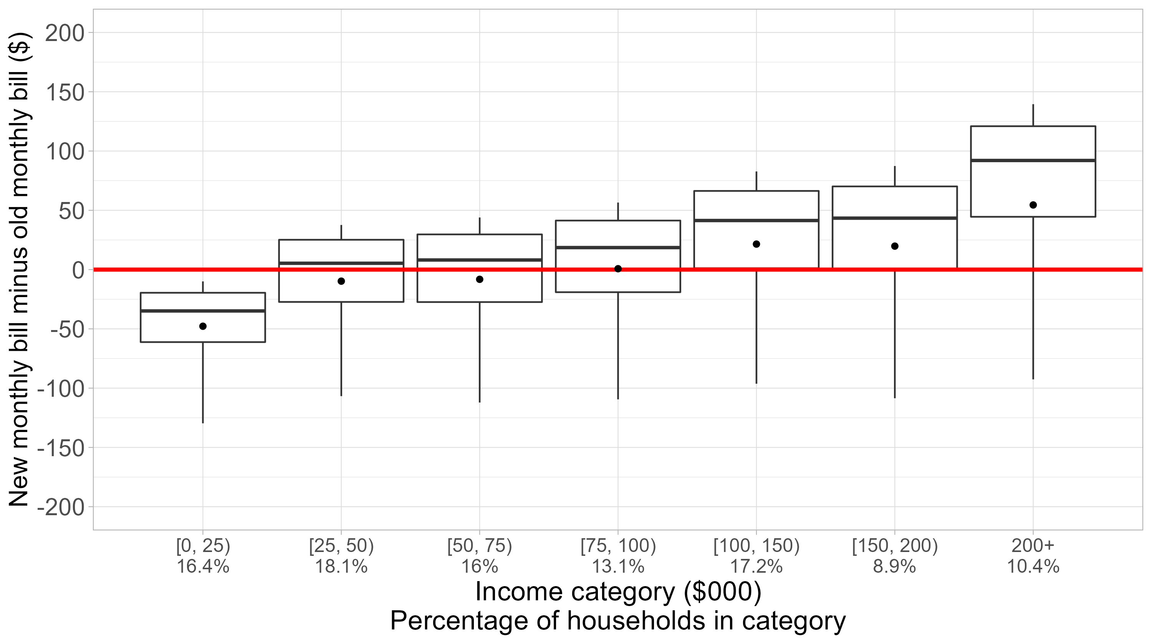
Effect on Monthly Bills (PG&E)
Volumetric prices are much lower, so net impact on bill depends on both consumption and the IGFC.
A negative number in figure indicates bill reduction under IGFC approach.
Wealthiest households would see bill increase of about $51 on average.
Bill impacts will vary substantially depending on consumption.
Effect on Monthly Bills by Income Bracket
Box and whisker plot shows the mean impact in a group (dot), the median impact (bar), the 25th to 75th percentile impact (box) and the 5th and 95th percentile (lines).

Slide 10
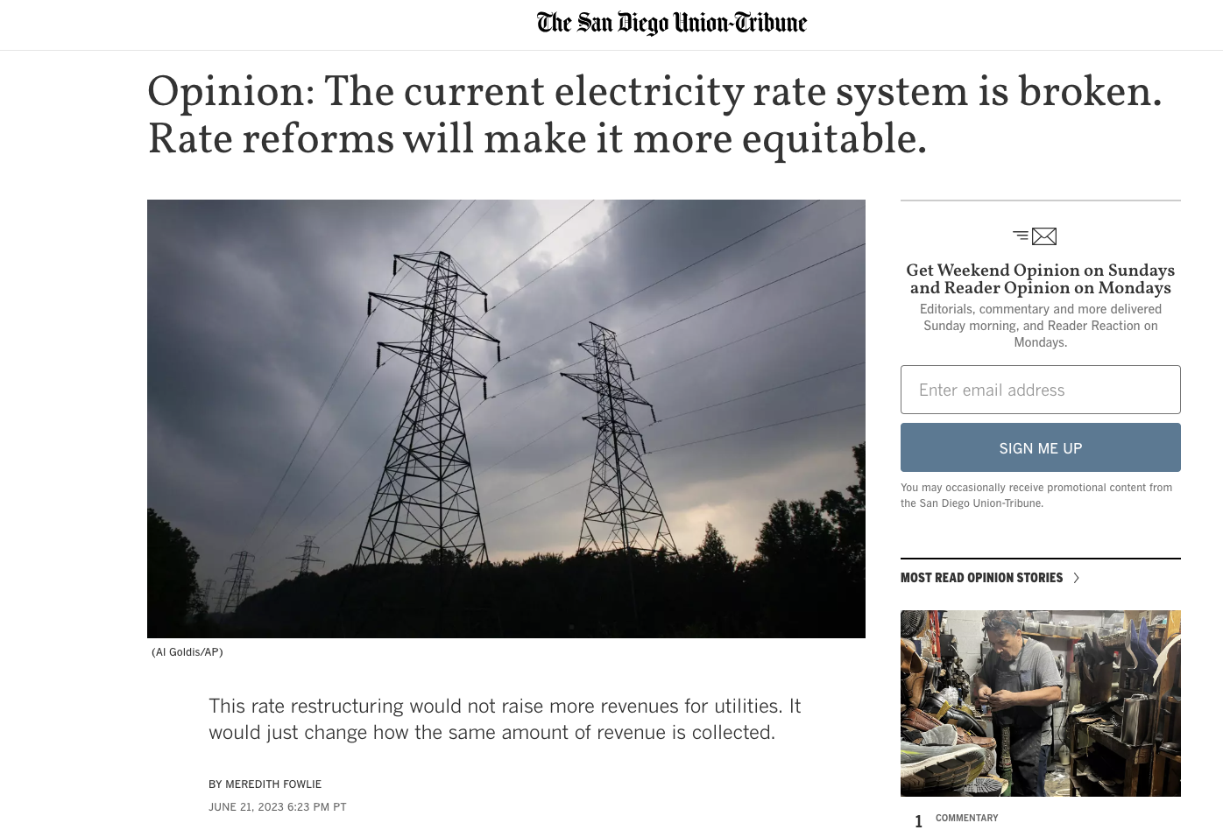
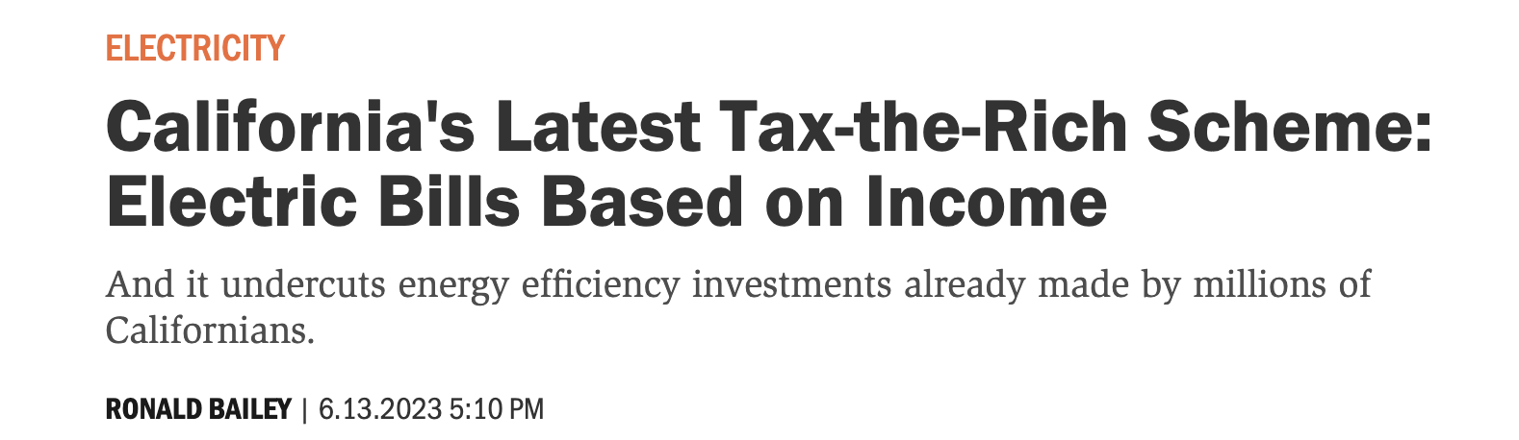
California rate reform in progress…
New law directs California’s utilities to implement an income graduated fixed charge.
Not without controversy…stay tuned!

Slide 11
Related Work:
Borenstein, Fowlie and Sallee. Designing Electricity Rates for An Equitable Energy Transition, Energy Institute at Haas Working Paper #314, February 2021
Borenstein, Fowlie and Sallee. Paying for Electricity in California: How Residential Rate Design Impacts Equity and Electrification, Energy Institute at Haas Working Paper #330, September 2022

