Slide 1
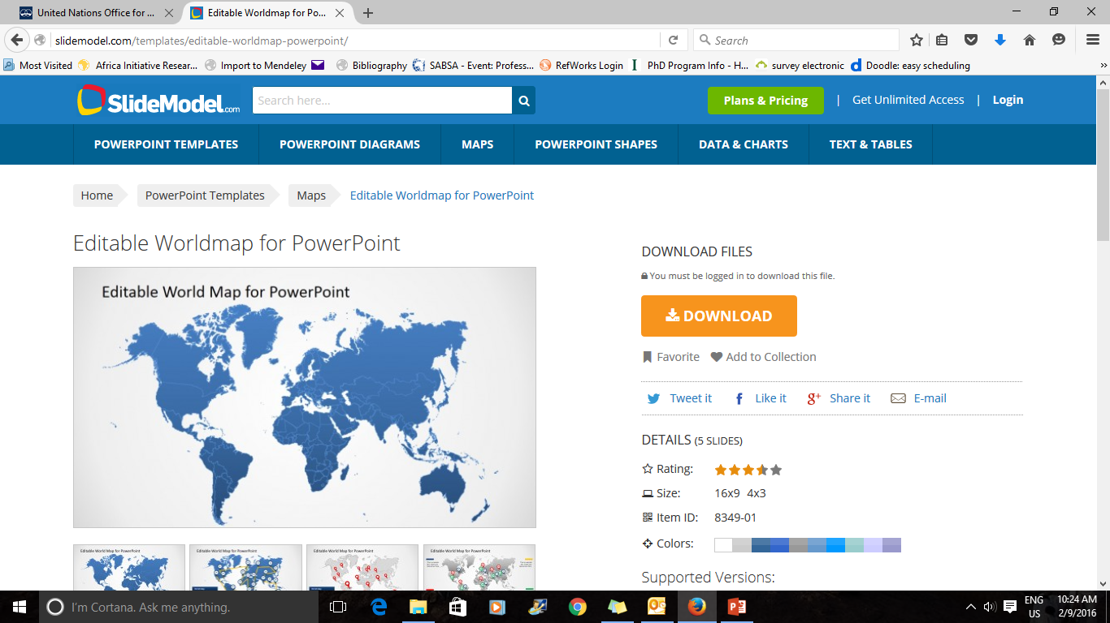
The Transferability of Western Business Education to the East*
By: Paul W. Beamish
Ivey Business School
Western University
Canada
  *Journal of Management Studies, 2020, 57(1):163-170.

Slide 2
Objectives of the JMS Call For Papers
Establish a foundation for the development of the exchange of ideas between East and West
Look at similarities and differences in the East and the West
Clarify how the East may form boundary conditions to the established theories/practices in the West
Help lay the foundation for indigenous theory building from the East (which the West can learn from)
Determine whether business models (here, business education models) in the East and West will/should converge

Slide 3
This presentation…
Focuses on the promotion of a teaching practice common in the West (the use of the case method) to the East (specifically China)
Based on:
16⁺ years as Executive Director of Ivey Publishing(IP), the World’s second largest producer and distributor of business cases, and my efforts to internationalize IP
30⁺ years teaching in the West
30⁺ years of annual visits to China
Utilization of Rogers’ ‘Diffusion of Innovation’ model
Experience writing >40 published teaching cases about business in China

Slide 4
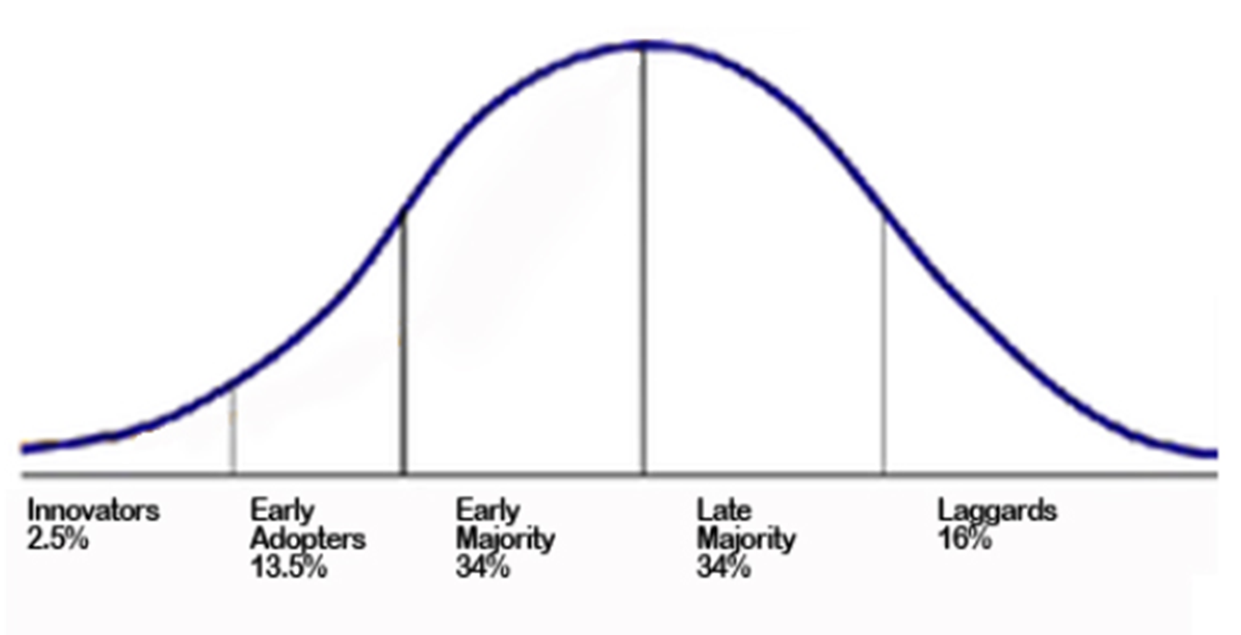
Diffusion of Innovation
1979 1987 2002 2016
Source: Rogers, E. M. (1962). Diffusion of innovations. New York: Free Press of Glencoe His theory explains how, why, and at what rate new ideas and technology spread through cultures.

Slide 5
East-West Models of Business Education
North America/ W. Europe | China
Individual professors→ student | Site license
Existing supply adequate | Want more
High | Improving
Mixed | Modest
2-3 courses per term | 3-3⁺
Mixed | Very high
High | Low
Mixed | Low
Mixed | Extremely low
Case distribution
Local content
% faculty with PhD
Importance attached to performance in classroom teaching
Average teaching load
Emphasis on lecturing
Cost of books
Daily prep required by students
Average undergrad tuition

Slide 6

Case Method vs Lecture
Case Method

Slide 7
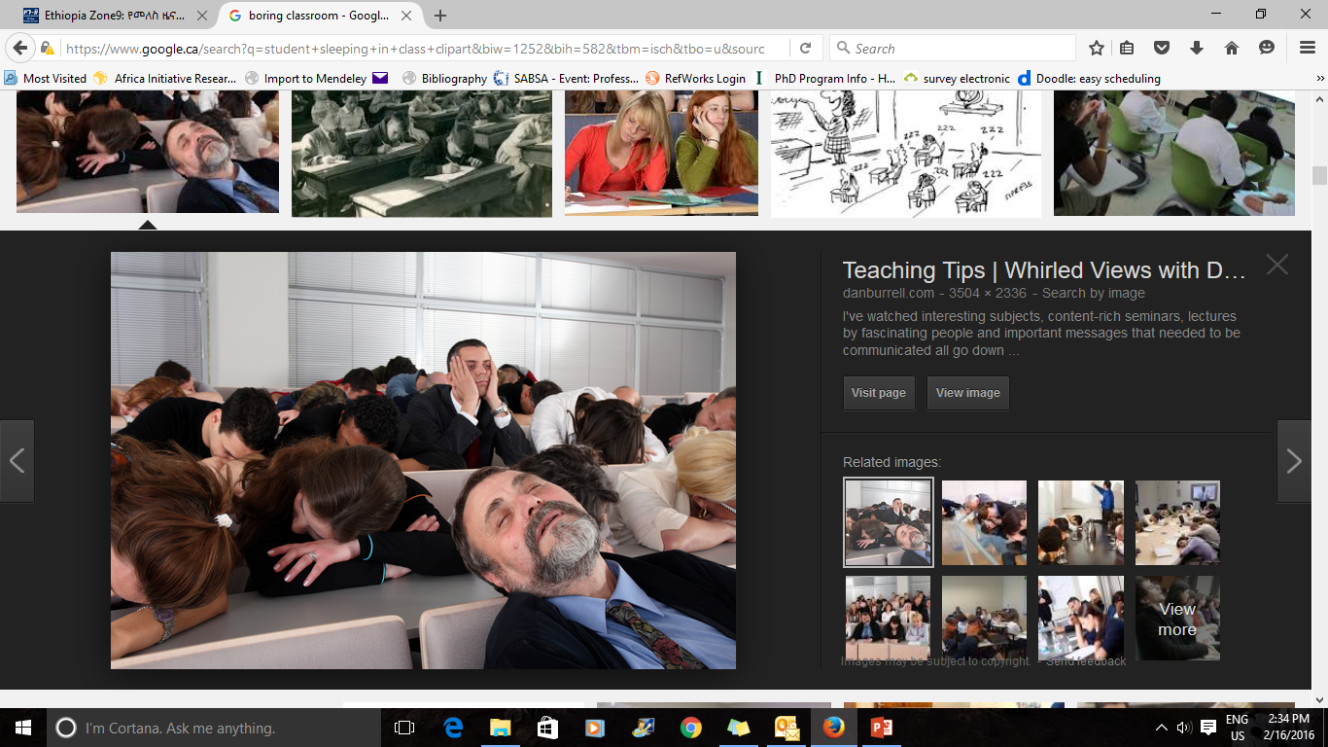
Lecture

Slide 8
Why Teach with Cases?
Student Reasons
Engages students; they retain learning longer
Develops their decision making skills, and critical thinking skills, making them better future leaders
100% of top MBA-schools use cases (on average for about one-third of class sessions)
Professor Reasons
It’s not boring!
You learn when teaching a case
MOOCs will reduce the need for b-school lecturers
Can be easily linked to models/frameworks/theories

Slide 9
Background
Ivey has long been active in Greater China
  Research
  Teaching
First North American business to establish a degree program campus there (in HK)
Extensive case study writing (and distribution, via Ivey Publishing)
From 1984-94 via CIDA-sponsored “China Project” with Tsinghua’s School of Economics and Management, and 2 other Chinese b-schools.

Slide 10
Cont’d.
In the early 1980s, the state of management education in China was very under-developed. The country supported rapid growth in its number of degree granting business schools.
Chinese visiting scholars learned a great deal during their visits. They observed first-hand how a market economy functioned, and how a business school functioned within such a context. Exposure to alternative models allowed them to think about how to bring back to China the relevant elements.
They were introduced to new, current teaching material (both textbooks and case studies) which they could draw from for their new reality.

Slide 11
Evolving Perspectives of the Tsinghua Dean
Early 1980s (after viewing a case class at Ivey for the first time)
“That was really interesting, but it will never work in China”
Early 1990s (as a lead committee member of the State Education Commission for MBA programs)
“ We are henceforth requiring that 25% of MBA content in China must be taught using cases”

Slide 12
Phase I of China Project
35 articles, cases, notes published
9 Ivey faculty visited Tsinghua to lecture
12 Tsinghua faculty to Ivey for a year
8 Tsinghua graduates of Ivey MBA
All visiting professors from Tsinghua attended Case Writing and Case Teaching Workshops

Slide 13
What worked?
A major strength of the linkage was continuity. The same key people were in place during and after the 10 year funding period. This allowed personal relationships/friendships/trust to develop, which in turn created an environment in which complex issues could be managed more easily.
What challenges arose?
First, if Chinese faculty had limited facility with English, they were unable to derive as much of the desirable benefit. Second, the issues around the Tiananmen Square protests of June 1989 resulted in a number of Chinese visiting scholars in Canada not returning home. This slowed progress in the linkages. Third, the administrative burdens for CIDA contracts were heavy.

Slide 14
Phase II of China Project
3 new Chinese b-school partners were added
1992 program was delivered on teaching “Joint Ventures, Technology Transfer, and International Trade via The Case Method”
1992: first of 5 IB case books published by Tsinghua University Press
1993: publication of 6 additional case books by our other Chinese partner schools

Slide 15
Cont’d.
The two Phases of the China project laid the groundwork for three major case-study related initiatives by Ivey in China over the next two decades
Ivey-Tsinghua Casebook Series (1998 – 2002)
Annual Case Teaching/Writing Workshops at Tsinghua (since 1998)
Ivey Publishing’s Case Distribution in China

Slide 16
Initiatives
1) Ivey-Tsinghua Casebook Series (35 Books Published,1998 – 2002)
In response to the education ministry’s decree that 25% of MBA courses be taught using the case method, 16 MBA casebooks for China were published in English in 1998 in China, in collaboration with Tsinghua.
Translations of these 16 casebooks in expanded form were published in Chinese in 1999. Each book involved an editor from Ivey and an editor from Tsinghua

Slide 17
Cont’d.
Some of the more popular Chinese casebooks were expanded again in 2001 – 2002 into second editions, along with the introduction of casebooks on three new topics.
In addition, 18 best-selling textbooks in the west, jointly recommended by Ivey faculty and Tsinghua faculty, were reprinted in 1998 for use in China.

Slide 18
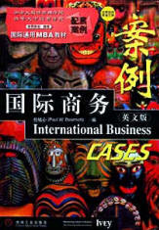
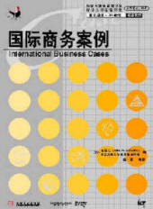
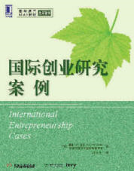
Examples

Slide 19
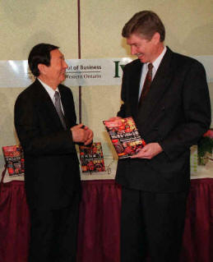
Casebook Series Presentation to Premier Zhu Rongji
Professor Paul Beamish, presented the largest ever collection of business casebooks produced for China to Zhu Rongji, Premier of the State Council of the People's Republic of China (left). The former Premier, who had served as Dean of the School of Economics and Management at Tsinghua, received the casebooks during his official visit to Toronto, Canada in April 1999.

Slide 20
Ivey Casebooks(in Chinese or English) via Chinese Commercial Publishers, cumulative
70—
60—
50—
40—
# of
casebooks
30—
20—
10—
1990 1995 2000 2005 2010 2015
Year

Slide 21
Cont’d.
Annual Case Teaching/Writing Workshops at Tsinghua (since 1998)
For over 15 years, a Hong Kong based foundation provided funding for annual Ivey-Tsinghua Case Teaching and Writing Workshop. Over 1,000 Chinese university professors attended.
Ivey professors continue to offer workshops at other universities throughout China. More than 2,000 additional Chinese professors have attended these workshops.

Slide 22
Cont’d.
3) Ivey Publishing in China
Ivey Publishing is the world’s second largest producer of business school teaching cases, after Harvard. It has over 5,800 items in its current collection. Over 1,500 Ivey cases or Ivey Business Journal articles are available in simplified Chinese with many more being translated annually. By practice, all Ivey cases or IBJ articles involving China are translated into Simplified Chinese, as are all Best Sellers.

Slide 23
Cont’d.
Ivey Publishing (IP) has nearly 600 cases involving China in its current collection.
Ivey cases are used all over China via site licenses with Chinese b-schools, casebooks or loose sales.
IP has customized (prof-to-prof) case writing training programs with 3-4 Chinese b-schools at any given time.
IP has hosted multiple visits by deans and case center directors from China for a 2 day workshop on how to set up and manage a case center. (There are over 50 case centers in Chinese b-schools.)
IP has dedicated Chinese speaking publishing support staff.
Thousands of Chinese professors are registered with IP.

Slide 24
Chinese Government is Embracing the Case Method
In 2013, a delegation from the China Academic Degrees and Graduate Education Development Center (CDGDC), Ministry of Education visited IP.
CDGDC had been entrusted with a new task by the Ministry: to build a national-level case center for professional degrees education in China. There are now nearly 40 professional degree majors in China and their proposed case center is intended to help ALL of them!

Slide 25
Progress
Ivey casebooks for the Chinese market have sold hundreds of thousands of copies, and millions of copies of Ivey cases have been studied in China.
Working with foreign colleagues in sourcing the material and in translating our cases into Chinese has improved the quality of the original English-language versions. It forced us to recognize and remove colloquialisms, clarify ambiguous words or phrases, and eliminate any ethnocentric biases which may have unconsciously crept in.

Slide 26
Insights in Case Studies from the East
THEME | EXAMPLE
Health care innovations | Lots from India
Home delivery of fresh products (last mile program) | Fishbay.in—Fishing on the Net (9B15A020)
App combining a cultural tradition(gift giving at Chinese New Year) and mobile payment adoption | Tencent: The WeChat Red Envelope Initiative (9B15M045)
New Marketing channel: customers receive entertainment and advertising with missed calls | Hindustan Unilever Limited (9B15A037)
Guanxi-style relationship networks | Recruitment at China Sunwah Bank: Guanxi versus Talent (9B14C010)
Generational( 1980’s) work values in China | Zhu Dandan (A): Promotions (9B13C002)
Corporate collusion within industry sections | Tianlong Company and the Toxic Capsule Scandal (9B12M103)
Pattern of internationalization of MNE from a “Next 11” country | Walton: Building a Global Brand Through Internationalization (9B16A001)
Chinese companies and copyright violation | Crisis at the Bally Wedding Dress Company (9B15M117)
Reverse innovation | GE China Technology Center: Evolving Role in Global Innovation (9B15M099)
Creative improvisation (Jugaad) as a framework for sustainable management systems. | Sitara: Indian Management Style – Capturing Hearts and Minds (9B12C028)
Organizational Justice in the workplace. | Jinjian Garment Factory: Motivating Go-Slow Workers (9B04M033)

Slide 27
Yet, Broad-Based Adoption of the Case Method Has Been Slow in Many B-Schools. Why?
China had to first:
scale up business education using traditional methods (lecturing).
increase the competency level of local faculty.
understand the limitations of an education model based solely on lecturing/rote learning.
develop a generation of students who are receptive to a participatory classroom model rather than the top down model
align the internal faculty reward systems for writing cases.

Slide 28
Selective Ivey Case-Related Milestones Re China Case Method Introduction
Innovators (2.5%) Early Adopters(13.5%) Early Majority(34%)
1979 1987 2002 2016
Chinese language website established
Mass translation of Ivey cases
Case writing training contracts instituted
Ivey case method workshops in China (entire period)
Ivey custom workshops for case centre directors
1999- Ivey establishes campus in HK
Site license model for case sales initiated
Ivey-Tsinghua Casebook series

Slide 29
Selective China-Initiated Milestones Re Case Method Introduction
Stage
%
Innovators (2.5%) Early Adopters(13.5%) Early Majority(34%)
Time
1979 1987 2002 2016
In 2013, Ministry of Education unit visits Ivey for guidance re their plan to set up massive case center
CMCC established to share local cases
Dalian introduces “Case Writing Journal”
State Education Committee for MBA programs mandates 25% use of cases
In collaboration with Ivey, Tsinghua faculty co-edit & publish dozens of casebooks
Workshops by Changhui Zhou at PkU over 3k profs attended
80+ b-schools establish case centers

Slide 30
Factors Influencing Adoption of an Innovation
Factors | In China
Relative Advantage ̶ degree to which it is seen as better than the approach it replaces | Advantages very clear to practicing managers(EMBA)
Compatibility ̶ how consistent is it with the needs of potential adopters? | Some faculty like to be seen as relevant/current with foreign practice
Complexity ̶ how difficult it is to understand/use | Easier to understand than to use effectively. Some training is helpful.
Triablility ̶ the extent to which it can be tested before the commitment to adopt | Easy to replace/supplement lectures one by one
Observability ̶ extent to which it provides desired results | Teaching ratings/enrollments provide answers

Slide 31
Will the East vs West Education Models Converge?
  Never completely; and any rapid convergence would require a rethink of existing practices.
Should they converge?
  No. It would be ethnocentric for us to assume so. China, and its individual professors, can decide the extent to which they will, or won’t, borrow from the West.

