Slide 1

The Future of Electricity Markets
October 28, 2020
Presented to
Presented by
4th Annual Workshop on the Economics of Electricity Policy and Markets
Kathleen Spees

Slide 2
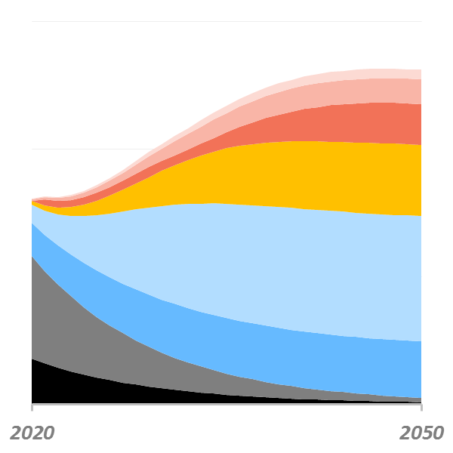
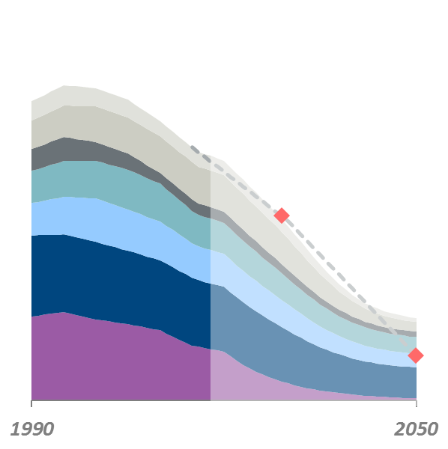
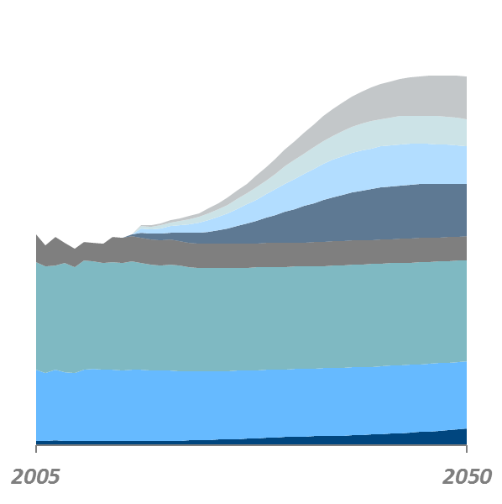
The Clean Energy Transition is Happening…
…markets or no markets.
Economy-wide GHG Emissions
Electrification
Supply Mix
MMTCO₂e
TWh
TWh
1.5-3x historical demand needed to hit 80% decarb
DR
EE
Other
Industrial
Storage
Non-Energy Sources
Baseline + EE
Commercial
Industrial
Residential
Solar
Commercial
40x30
Transportation
Residential
Industrial
Wind
Transportation
Commercial
80x50
Gas
Electricity Gen
Residential
Transportation
Coal
Hydro
Policymakers and customers sets GHG emissions targets to address climate change
Demand growth from policy-and customer-driven electrification
“Non-traditional” supply resources will be the dominant source of energy economy-wide
Examples: New England in an 80x50 decarbonization pathway and New York Grid in transition study.

Slide 3
What Do Markets Look Like with Planning or Contract-Driven Decarbonization?

Slide 4
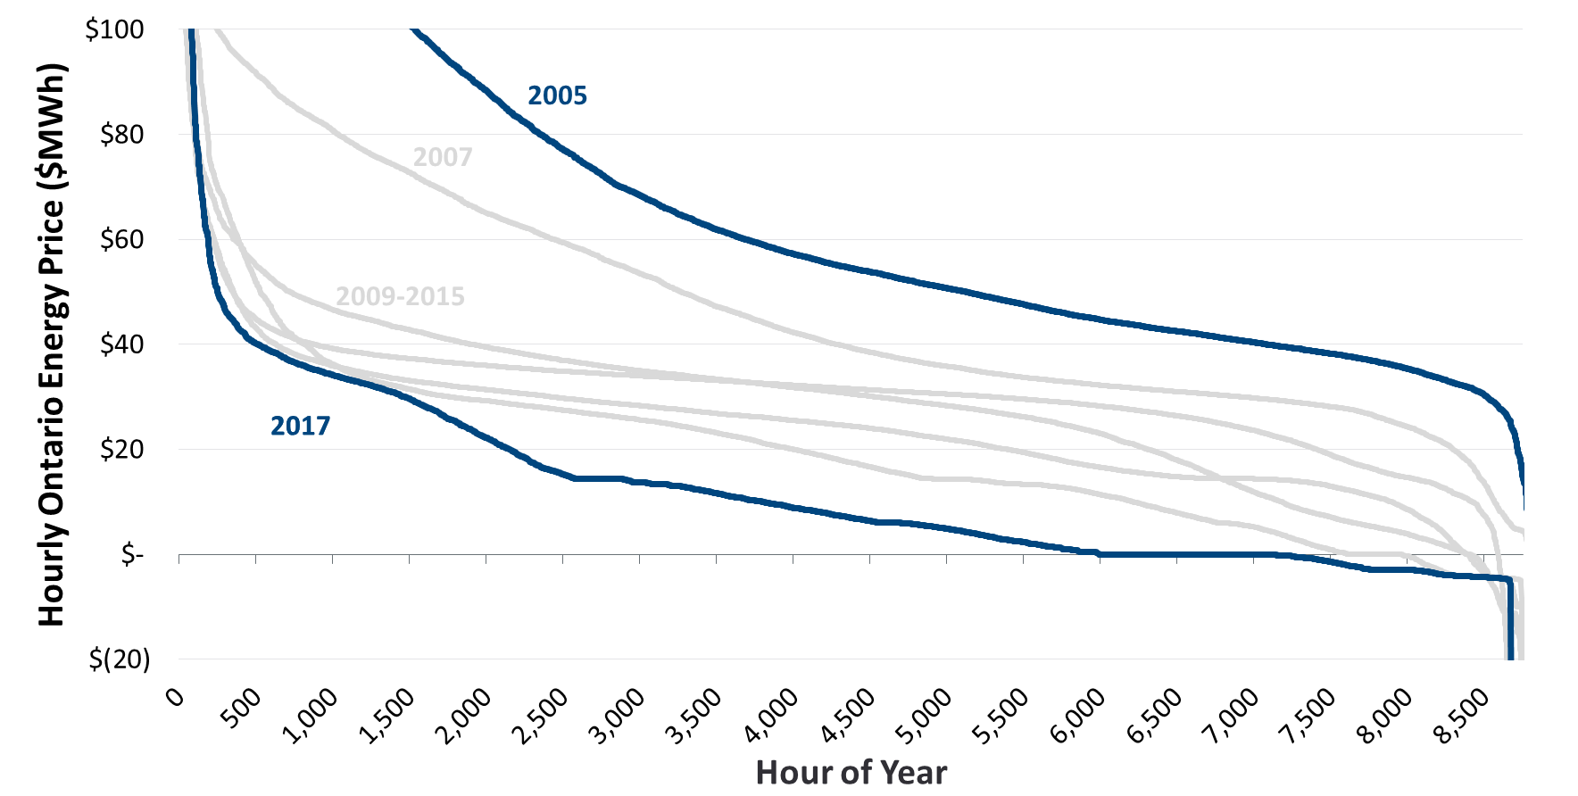
Ontario: Energy Market “Bottoms Out”, Enhancing the Importance of Proper DR, Storage, Hydro, and Scarcity Pricing
Energy prices have fallen 79% with decarbonization. 10 TWh of clean energy spilled in 2017

Slide 5
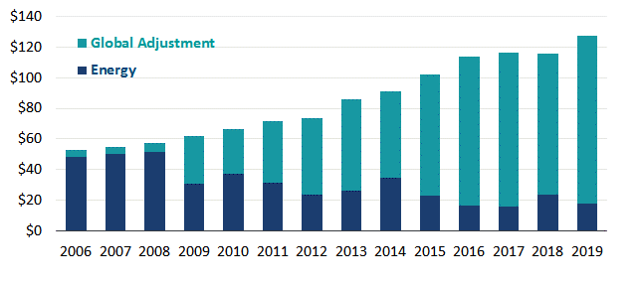
Ontario: Customer Bills Illustrate the Diminishing Role of Markets to Drive Electricity Sector Efficiencies
Total addressable market size is declining. Energy and ancillary markets continue to play an essential role in achieving operational reliability at the lowest cost, but have a very limited role in driving investment efficiencies.
Contract Payments
Energy Market
Customer Bills ($/MWh)

Slide 6
Start by Rethinking Reliability for the Grid in Transition: Are We Headed for Blackouts When the Sun Goes Down?
Myths | Realities
Intuition may give us a false sense that the grid won’t stay reliable unless we…. Save baseload plants from retirement (or coal, or nuclear, or gas) Save a specific “favored” plant Stop building renewables Build a gas pipeline Impose on-site fuel requirements Assume that renewables (or demand response) are totally “unreliable” unless they can operate in the same way as a traditional thermal plant | It’s not all hype. It will be a big challenge maintain reliability while going clean… Customers & states want to go clean. “Reliability card” will not stop them Intermittent renewables do not provide the same bundle of reliability services as thermal plants Grid services we used to get “for free” will need to be defined and paid for Grid operators must learn to rely on non-traditional resources to provide these grid services Customers may prefer to save money by allowing some outages

Slide 7
Markets Will Increasingly Need to Re-Define (and Price) Reliability Needs
  Easy (but wrong): First instinct of RTOs & utilities may be to continue relying on traditional thermal plants even as they become uneconomic
  Harder (but right!): Do the hard work of fully specifying a comprehensive suite of unbundled grid services… before the problem becomes an emergency requiring costly interventions
Express Reliability Needs as Well-Defined, Unbundled Products
Determine the Efficient Quantity & Willingness to Pay
Enable All Resource Types to Compete
Procure Needed Services in a
Co-Optimized, Competitive Fashion

Slide 8
But Where are the Opportunities for Markets to Provide More Value in a 50-100% Clean Grid?

Slide 9
Grid SIM: Brattle’s Cutting-Edge Tool for Analyzing Resource Mix, Policy Levers & Market Design for Deep Decarbonization
Inputs
GridSIM Optimization Engine
Outputs
Supply
Existing resources and flexibility limitations Investment, fixed, and variable costs New technology (DR, DER, storage, EVs) Reliability contributions (ELCC, AS capability)
Demand
Representative day hourly demand Capacity, ancillary & reliability needs
Transmission
Zonal and intertie limits Neighboring regions (full or simplified)
Regulations, Policies, Market Design
Capacity market Carbon policy (cap, price, rate-based, other) Energy policies, RPS, technology carve outs, clean energy market designs
Objective Function
Minimize NPV of Investment & Operational Costs
Constraints
Market Design and Co-Optimized Operations Capacity Energy Ancillary Services Regulatory & Policy Constraints Resource Operational Constraints Transmission Constraints
Annual Investments and Retirements
Hourly Operations
Supplier Revenues
Emissions and Clean Energy Additions

Slide 10
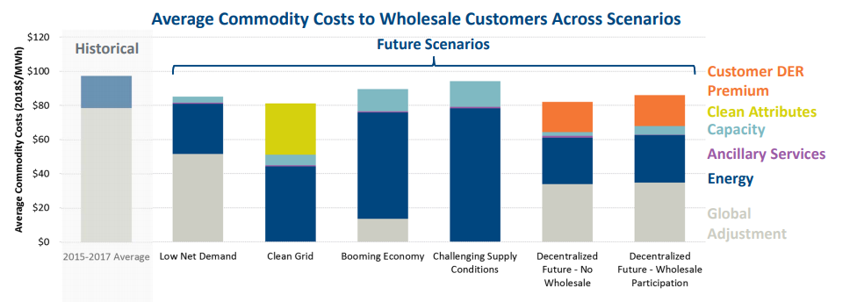
Ontario: Assessing Customer Costs Across Market, Clean Energy, and Economic Scenarios in 90% Clean Energy Market
Future markets may need to evolve significantly to meet policy needs. Particularly to develop robust clean energy markets & distribution resource markets
Distributed Resource Markets
Long-Term Contract Payments
See Brattle’s Study of Ontario’s Future Market Evolution.

Slide 11
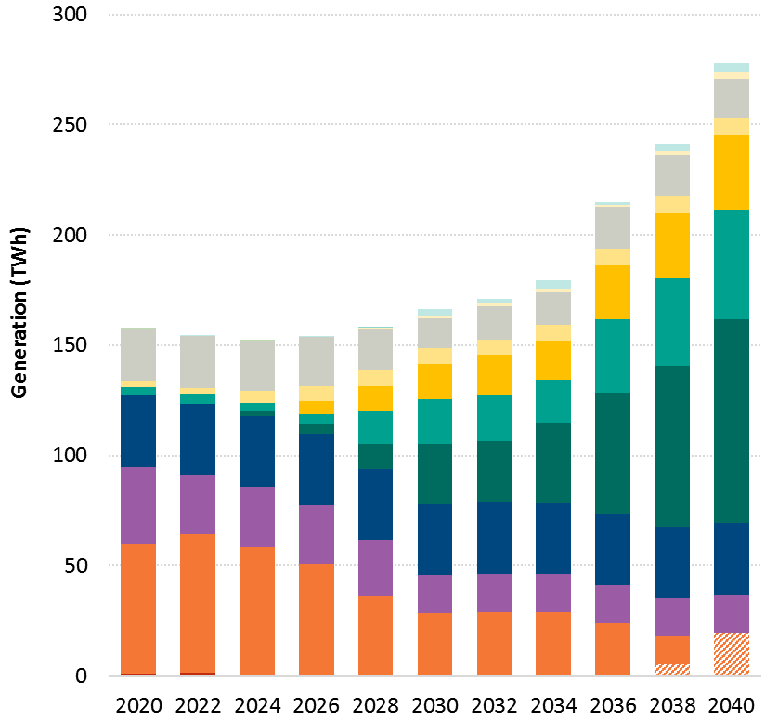
New York: Transition to Zero Emissions Generation
Generation (TWh)
Minimal curtailments due to short- and long-term balancing (including RNG production)
Wind Curtailment
Solar Curtailment
Net Imports
Distributed Solar
Solar
Onshore Wind
Wind and solar become primary source of energy
Offshore Wind
Hydro
Nuclear
Natural Gas
Gas-fired generation falls, eventually switches to zero-emission fuel sources (RNG)
Zero-Emission Fuel (RNG) (Striped)
Biogen
See Brattle’s Study of New York ISO’s Grid in Transition.

Slide 12
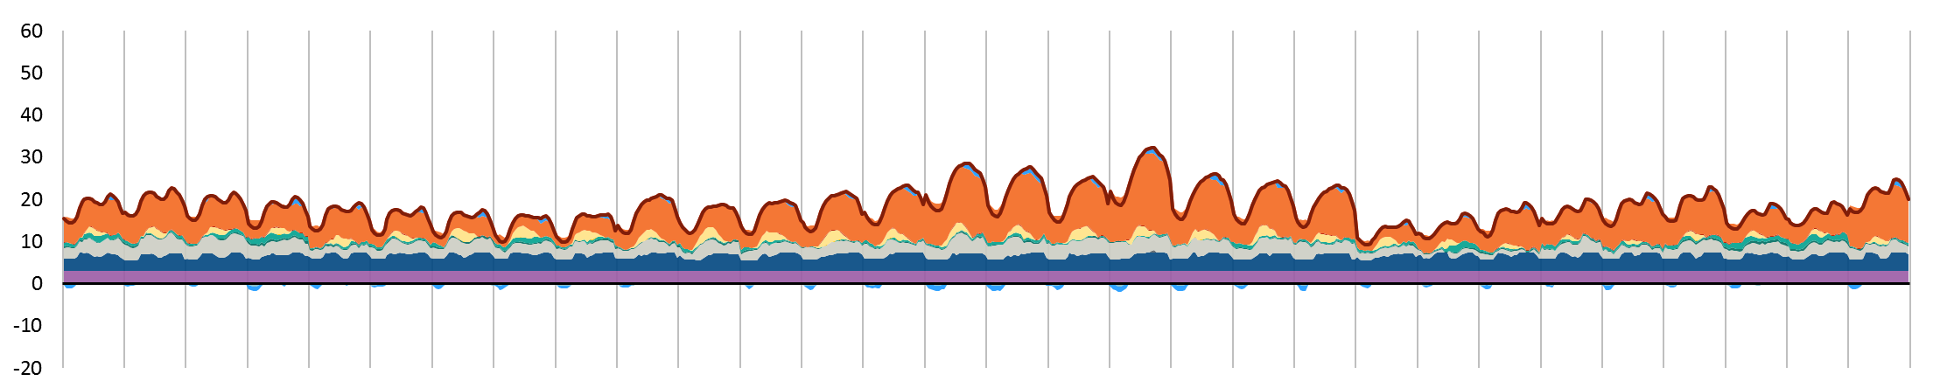
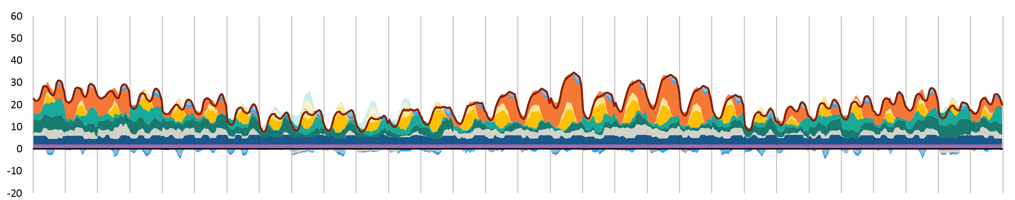
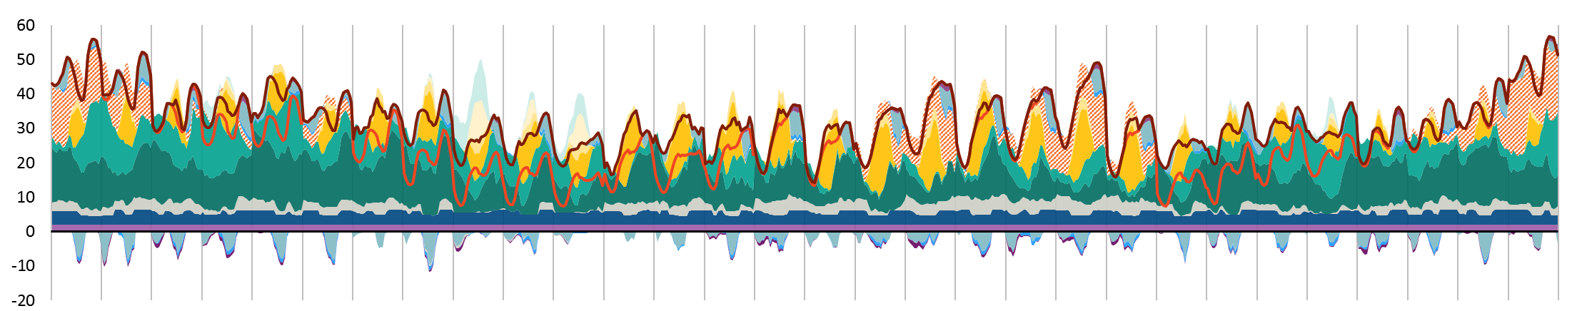
New York: Future 100% Carbon-Free Grid Will Badly Need Flexible Supply and Flexible Customers
Generation and Load, GW
2024
Wind Curtailed
Solar Curtailed
Flexible Load
Storage
Pumped Storage
Gas
Zero-Emission Fuel (RNG) (Striped)
2030
Distributed Solar
Solar
Onshore Wind
Offshore Wind
System load
Interties
System load minus RNG production load
Hydro
2040
Nuclear

Slide 13
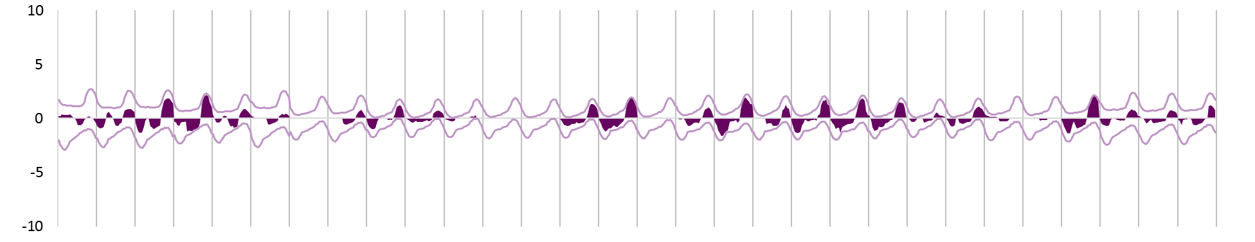
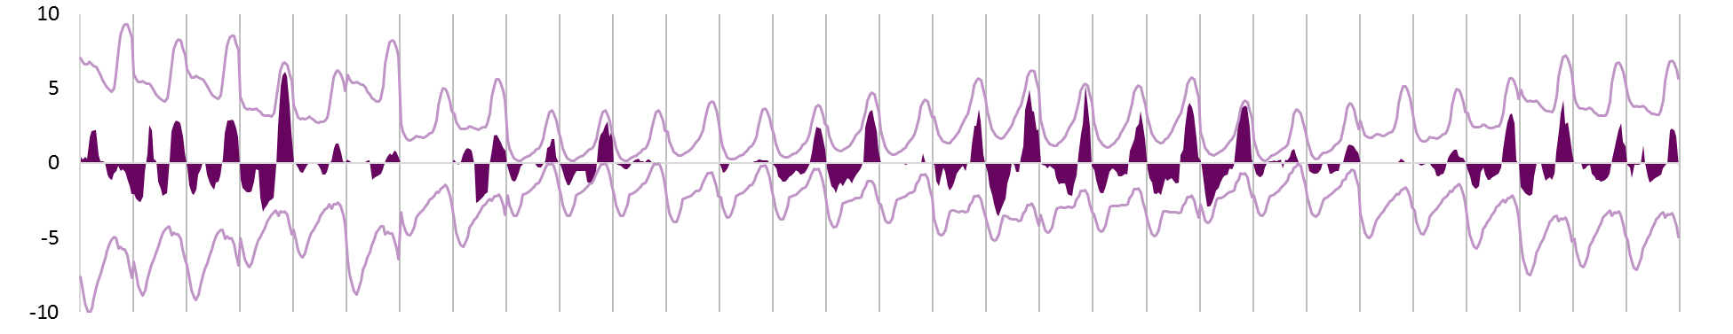
New York: Increased Customer Flexibility (Activated by Proper Market Signals) Will Be Increasingly Essential for Reliability & Cost
GW
Base Case
Change in load from baseline
Decrease in load
Max limit
Min limit
Increase in load
Jan
Feb
Mar
Apr -May
Jun
Jul
Aug
Sep-Oct
Nov-Dec
State-wide load flex often more valuable for reserves than energy
Increased Customer Flexibility Case
(More EV and DR Participation)
More active load reductions in afternoon peak hours
Much higher summer & winter load flex availability due to increased HVAC participation
Loads flex in standby used on days when there is less value in intraday energy arbitrage

Slide 14
Takeaways

Slide 15
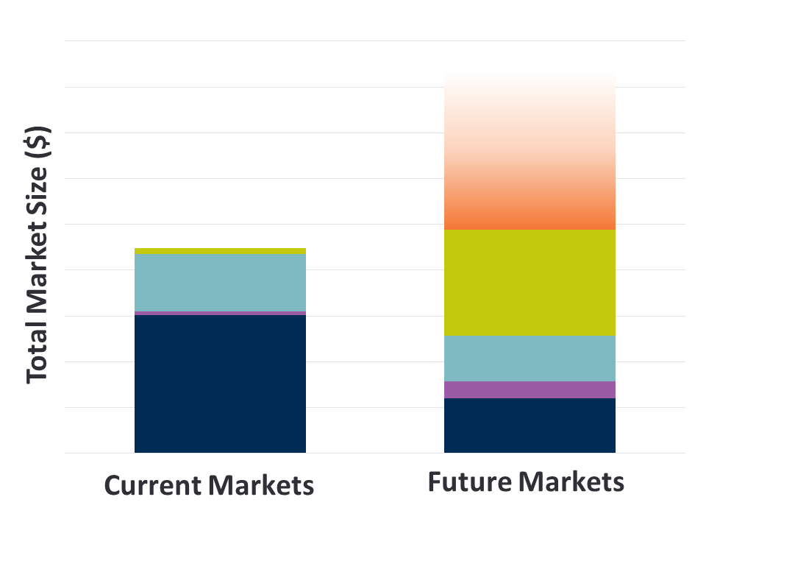
What Will the “Future Markets” Look Like?
Best Market Design
(20 Years Ago)
Best Market Design
(20 Years from Now)
Enabling markets for activating DR, electric vehicles, consumer devices, and related services
Adjacent
Customer
Products and Services
Clean Energy Attribute Markets
Capacity
Flexibility & Ancillaries
Energy
New Markets
Are needed to empower customers to meet their own carbon objectives & mobilize the grid edge with a wider array of tech-enabled services
Voluntary clean energy markets and CO₂ pricing to allow customers to meet environmental goals
Existing Markets
Timeless principles of reliability at least cost. But we need a rethink.
Start by assuming that “nontraditional” resources are the new normal
Designed for ….
Dispatchable thermal plants, inelastic demand
Intermittent wind & solar, storage, EVs, DR, interties, prosumers

Slide 16

Contact Information
Dr. Kathleen Spees is a principal at The Brattle Group with expertise in wholesale electricity markets design and environmental policy analysis.
    Dr. Kathleen Spees is a Principal at The Brattle Group with expertise in designing and analyzing wholesale electric markets and carbon policies. Dr. Spees has worked with market operators, transmission system operators, and regulators in more than a dozen jurisdictions globally to improve their market designs for capacity investments, scarcity and surplus event pricing, ancillary services, wind integration, and market seams. She has worked with U.S. and international regulators to design and evaluate policy alternatives for achieving resource adequacy, storage integration, carbon reduction, and other policy goals. For private clients, Dr. Spees provides strategic guidance, expert testimony, and analytical support in the context of regulatory proceedings, business decisions, investment due diligence, and litigation. Her work spans matters of carbon policy, environmental regulations, demand response, virtual trading, transmission rights, ancillary services, plant retirements, merchant transmission, renewables integration, hedging, and storage.
    Dr. Spees earned her PhD in Engineering and Public Policy within the Carnegie Mellon Electricity Industry Center and her MS in Electrical and Computer Engineering from Carnegie Mellon University. She earned her BS in Physics and Mechanical Engineering from Iowa State University.
Kathleen Spees Principal, Washington DC +1.202.419.3390 Kathleen.Spees@brattle.com

